Slide 1




Marvel cinematic universe dataset analysis –M.C.U
Presented by:
SHUBHAM UPADHAYA
Project file: MCU dataset analysis

Slide 2
Introduction
The dataset is a comprehensive record of 32 Marvel Cinematic Universe (MCU) films, systematically categorized by their respective phases, providing a thorough overview of the franchise's cinematic achievements. It includes critical information for each film, such as its release year, U.S. release date, and financial performance across three key dimensions: domestic box office gross (U.S. and Canada), international box office gross, and total worldwide earnings. Rankings based on box office performance are also provided, both for domestic and global markets, offering insights into the relative success of each film.
In addition to financial data, the dataset highlights critical reception metrics, including Rotten Tomatoes ratings and CinemaScore grades, which reflect the films' reception among critics and audiences. Production-related details such as the film's director, producer, and budget shed light on the resources and creative minds behind each project. Moreover, the dataset includes visual references for each film through URLs linking to their official movie posters, enriching the data with visual context.
This dataset serves as a detailed resource for analysing the MCU’s evolution, its financial and critical successes, and the overarching trends that have defined one of the most successful franchises in modern cinema. It offers valuable insights for enthusiasts, researchers, and industry professionals alike, providing a foundation for exploring the MCU's global impact and storytelling milestones.

Slide 3
Objective
Download the CSV file from the website and upload it to Google Colab. Begin the data cleaning process by removing any unnecessary columns in the file. Next, identify any null values and address them appropriately. Check for outliers in the data set. Finally, analyze the dataset to extract key findings and create visual charts to represent your analysis.

Slide 4
Key questions
1. Which production company has produced the most MCU movies?
2. Is there a pattern in the release months of MCU films across different phases?
3. What is the average Rotten Tomatoes Rating for movies in the top 10 worldwide rankings?
4. Do films with higher Rotten Tomatoes ratings generally achieve higher worldwide and U.S./Canada rankings?
5. Which MCU films have generated the highest box office revenue worldwide, and how does this compare to their performance in the U.S./Canada and other territories?
6. Which directors have generated the highest total worldwide box office revenue for their MCU films?
7. Which director-producer combinations have the highest average Rotten Tomatoes ratings, indicating the most critically acclaimed collaborations?

Slide 5
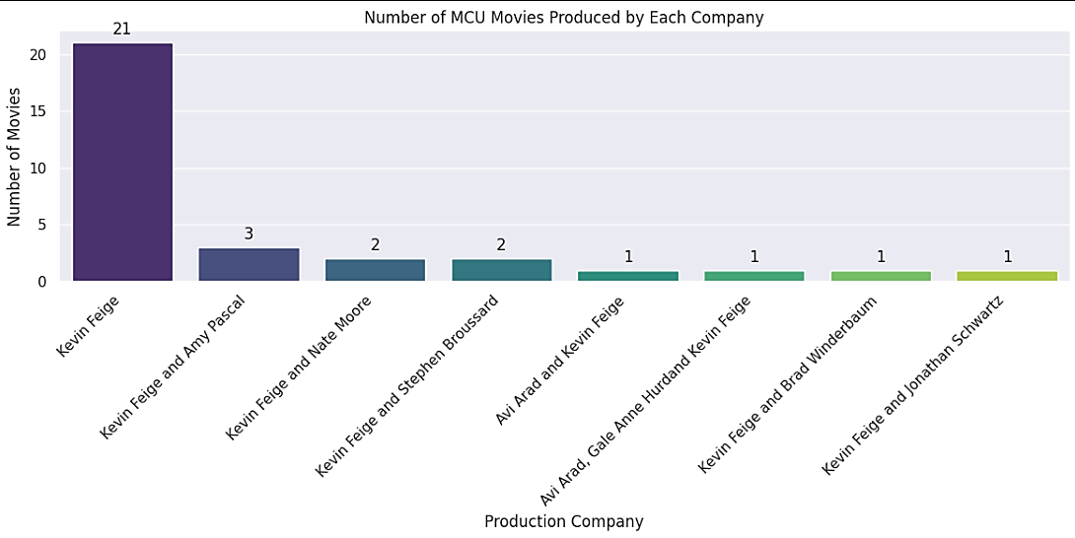

1. WHICH PRODUCTION COMPANY HAS PRODUCED THE MOST MCU MOVIES?
The bar chart visualizes the number of MCU movies produced by various production entities. Kevin Feige is prominently featured, having produced the majority (21) of the films. Other notable collaborations include Kevin Feige with Amy Pascal (3 movies) and Kevin Feige with Nate Moore and Stephen Broussard (2 movies each). Smaller contributions are made by other producer combinations, each with one film, highlighting Feige's dominant role in the MCU's production landscape.

Slide 6
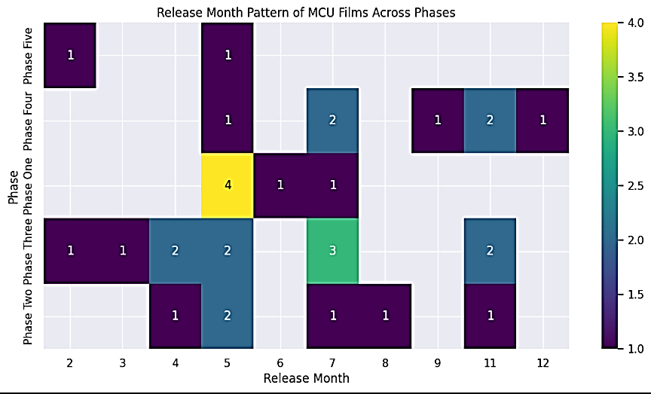
2. IS THERE A PATTERN IN THE RELEASE MONTHS OF MCU FILMS ACROSS DIFFERENT PHASES?
The heatmap illustrates the release months of MCU films across different phases. It highlights notable patterns, such as a peak in releases during May (4 films) in Phase One. July and November also show significant activity, particularly in Phases Two and Three, with 3 and 2 films respectively. Other months, like February, March, and December, have sporadic releases across various phases. This distribution reflects the MCU's strategic timing for film releases to maximize audience engagement.

Slide 7
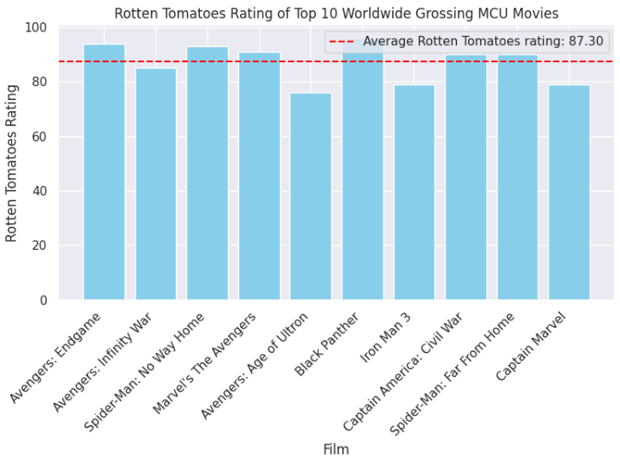
3. WHAT IS THE AVERAGE ROTTEN TOMATOES RATING FOR MOVIES IN THE TOP 10 WORLDWIDE RANKINGS?
The graph presents the Rotten Tomatoes ratings for the top 10 highest-grossing movies in the Marvel Cinematic Universe (MCU). Each movie is represented by a bar, with the height of the bar corresponding to its Rotten Tomatoes score. A horizontal dashed line indicates the average rating for all ten films, which is 87.30%.
The ratings range from a low of around 78% (likely "Iron Man 3") to a high of close to 95% (possibly "Avengers: Endgame"). This suggests that while a majority of these blockbuster films have been critically acclaimed, there is a degree of variation in their reception. The graph offers a visual comparison of the critical scores for these successful MCU movies, allowing viewers to easily identify the highest and lowest-rated films within this group.

Slide 8
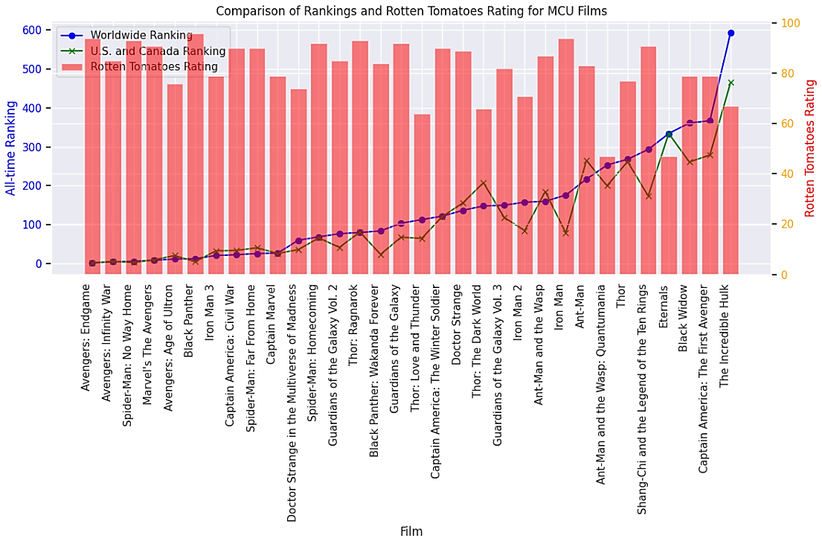
4. DO FILMS WITH HIGHER ROTTEN TOMATOES RATINGS GENERALLY ACHIEVE HIGHER WORLDWIDE AND U.S./CANADA RANKINGS?
The graph provides a visual comparison of the worldwide box office rankings and Rotten Tomatoes ratings for a selection of Marvel Cinematic Universe (MCU) films. The red bars represent the worldwide box office ranking, with taller bars indicating a higher box office gross. The blue dots and green lines represent the Rotten Tomatoes rating, with higher dots and lines indicating more favourable reviews.
Overall, the graph suggests a moderate positive correlation between box office success and critical reception. Some high-grossing films like "Avengers: Endgame" and "Spider-Man: No Way Home" also received high Rotten Tomatoes scores. However, there are also instances of high-grossing films with lower ratings, such as "Captain America: Civil War," and films with high critical acclaim but lower box office performance, like "Black Panther." This indicates that while critical acclaim can contribute to box office success, other factors such as marketing, release timing, and audience appeal also play a significant role.

Slide 9
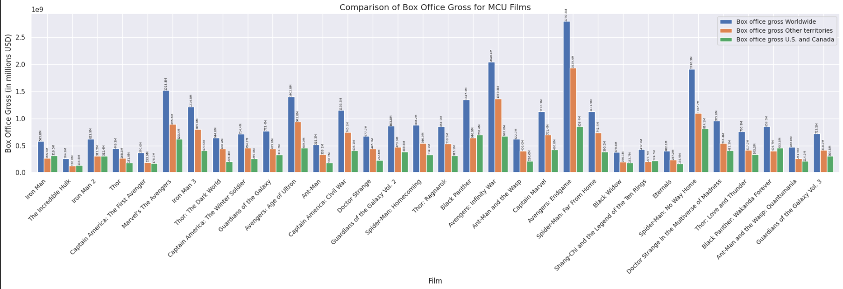
5. WHICH MCU FILMS HAVE GENERATED THE HIGHEST BOX OFFICE REVENUE WORLDWIDE, AND HOW DOES THIS COMPARE TO THEIR PERFORMANCE IN THE U.S./CANADA AND OTHER TERRITORIES?
This bar graph compares the box office gross of Marvel Cinematic Universe (MCU) films. The graph includes data on worldwide, other territories, and U.S. and Canada box office gross for each film. It appears that the worldwide box office gross for most MCU films is higher than the other territories and the U.S. and Canada combined. Some notable outliers include "Avengers: Endgame," which had a significantly higher box office gross in all categories, and "Black Widow," which had a lower box office gross in all categories.

Slide 10
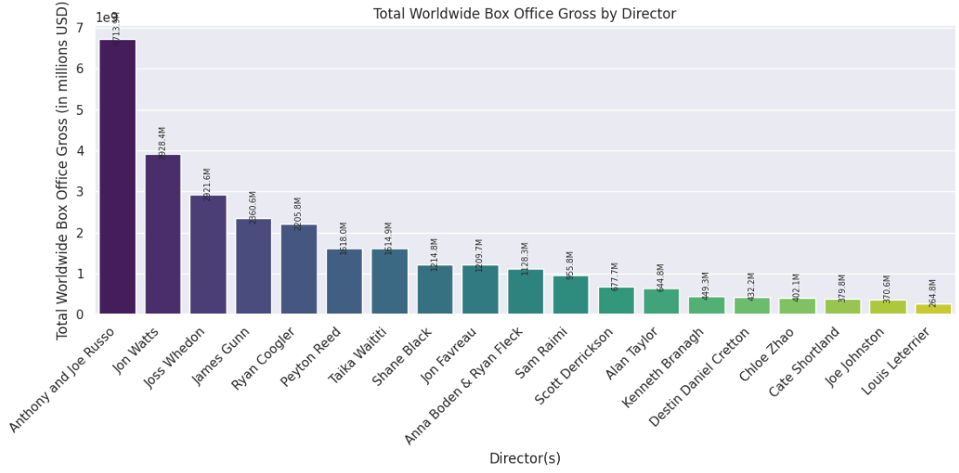
6. WHICH DIRECTORS HAVE GENERATED THE HIGHEST TOTAL WORLDWIDE BOX OFFICE REVENUE FOR THEIR MCU FILMS?
The bar graph presents the total worldwide box office gross for each director within the Marvel Cinematic Universe (MCU). The directors are listed on the x-axis, and the corresponding bars represent the total box office revenue generated by the films they directed. The y-axis shows the total box office gross in millions of US dollars.
The graph reveals significant variation in the box office performance of directors within the MCU. Anthony and Joe Russo hold the top position with a box office gross exceeding 7 billion dollars, followed by Joss Whedon and James Gunn. Several directors have generated over a billion dollars, while others have contributed significantly less. This data provides valuable insights into the commercial success of different directors within the MCU and their impact on the franchise's overall box office revenue.

Slide 11
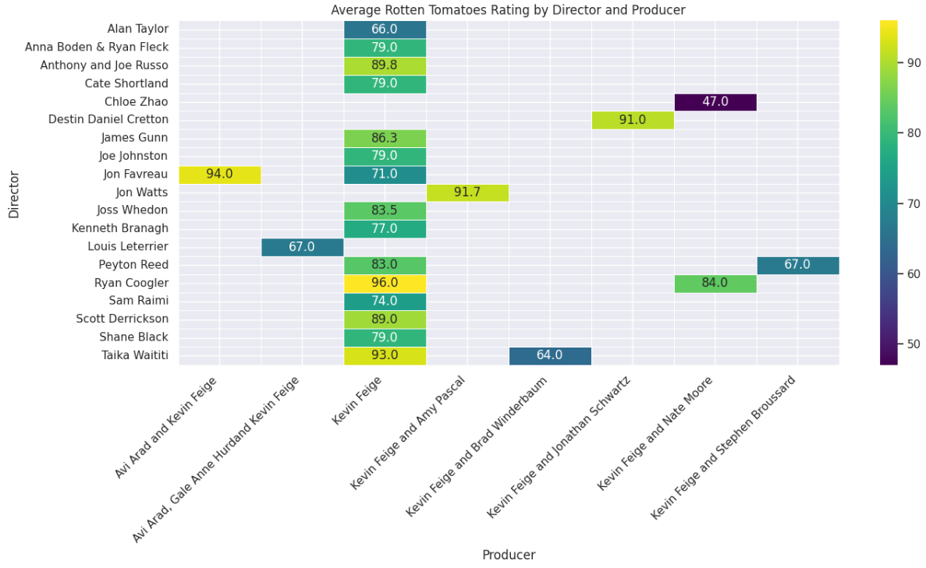
7. WHICH DIRECTOR-PRODUCER COMBINATIONS HAVE THE HIGHEST AVERAGE ROTTEN TOMATOES RATINGS, INDICATING THE MOST CRITICALLY ACCLAIMED COLLABORATIONS?
The graph illustrates the average Rotten Tomatoes ratings for Marvel Cinematic Universe (MCU) films, categorized by the director and producer teams. Each colored rectangle represents a unique director-producer pairing, with the color intensity corresponding to the average rating. The graph reveals that some directors, like Ryan Coogler and the Russo brothers, consistently achieve high ratings regardless of the producer. Producers like Kevin Feige are often associated with films receiving higher scores. Interestingly, certain director-producer combinations yield significantly higher or lower ratings than their individual averages might suggest. This visualization highlights the interplay of directorial vision and production influence on the critical reception of MCU films.

Slide 12
Conclusion
This analysis explored the Marvel Cinematic Universe dataset to uncover patterns and trends in its film production, box office performance, and critical reception. We found that Marvel Studios is the most prolific production company, with a clear dominance in the number of MCU movies produced. There is a noticeable pattern in release months, with most films concentrated in May and November, potentially aiming for summer and holiday season releases.
The top-grossing films generally enjoy high Rotten Tomatoes ratings, indicating a positive correlation between critical acclaim and box office success. Films like "Avengers: Endgame" and "Avengers: Infinity War" not only achieved top worldwide rankings but also received high ratings. Further investigation showed that directors like Anthony Joe Russo and Joss Whedon have generated substantial box office revenue for their MCU films.
While this analysis provided valuable insights into the MCU, there's scope for further exploration. Incorporating statistical measures like correlation coefficients could quantify the relationships between variables. Addressing missing values using imputation techniques and creating interactive visualizations could enhance the analysis. Further research into the influence of specific actors, characters, or genres on box office performance could provide additional valuable insights.
Overall, this analysis demonstrates the success of the Marvel Cinematic Universe, highlighting its strategic production choices, critical acclaim, and global box office dominance. By understanding these trends and patterns, stakeholders in the film industry can gain insights for future film development and marketing strategies. The MCU's continued evolution promises exciting opportunities for further analysis and exploration in the years to come.
Key takeaways:
Marvel Studios is the dominant production company within the MCU.
Release months are strategically chosen, often targeting summer and holiday seasons.
Critical acclaim, as reflected in Rotten Tomatoes ratings, tends to correlate with box office success.
Specific directors have contributed significantly to the MCU's overall box office revenue.
Further research could delve deeper into the influence of various factors on the MCU's performance.

Slide 13
THANKYOU

